Slide 1
Azure Infrastructure as Code Bootcamp
Azure Identity and Access Management

Slide 2




Tim Warner
timothywarner316@gmail.com
@TechTrainerTim
timw.info/linkedin

Slide 3
Course Agenda
Day 1
Authentication
Day 2
Authorization
Day 3
Accounting

Slide 4
Day 1

Slide 5
Day 1 Learning Goals
Overview of Azure AD
Manage Azure AD Users, Groups, Service Principals
Azure AD MFA
Azure AD Conditional Access
Azure AD Identity Protection
Azure AD Entitlement Management
Authentication

Slide 6
Course Materials
timw.info/inebootcamp
github.com/timothywarner/inebootcmap

Slide 7
AAA Security Model
Authentication (AuthN)
Authorization (AuthZ)
Accounting

Slide 8
Microsoft's "Zero Trust" Strategy
Strong user identity
Device health verification
App health validation
Least-privilege resource access

Slide 9
Crucial Azure Architecture Sites
Cloud Adoption Framework (CAF)
Well-Architected Framework (WAF)
Azure Architecture Center (AAC)

Slide 10
Azure AD Products
Microsoft Entra
Azure Active Directory (AD)
Microsoft Entra Permissions Management
Microsoft Entra Verified ID
Azure AD Business-to-Business (B2B)
Azure AD Business-to-Consumer (B2C)
Azure AD Domain Services (AADDS)
Citation: timw.info/

Slide 11
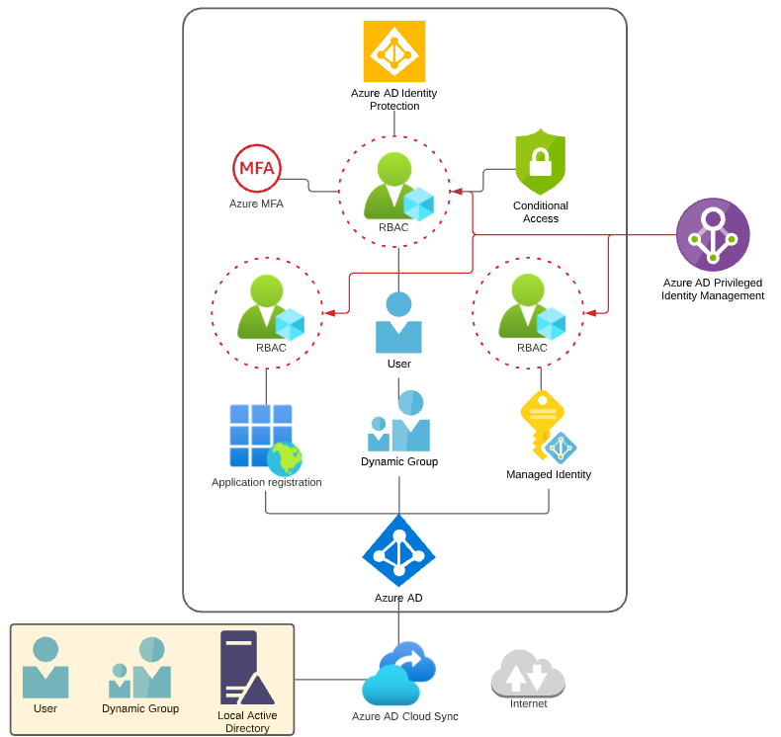
Azure Identity Scenario
Citation: timw.info/az500

Slide 12
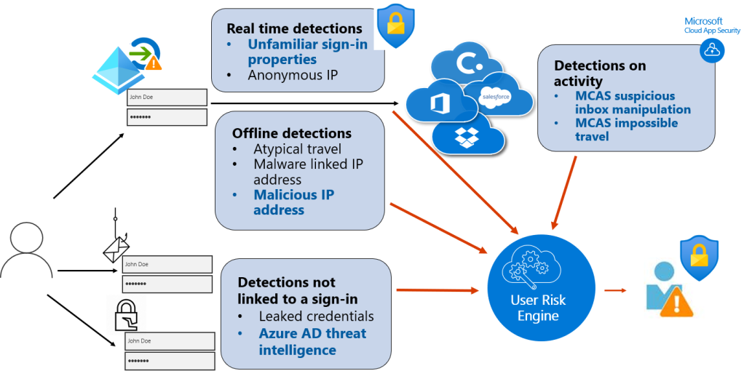
Azure AD Conditional Access
Citation: timw.info/2t1

Slide 13
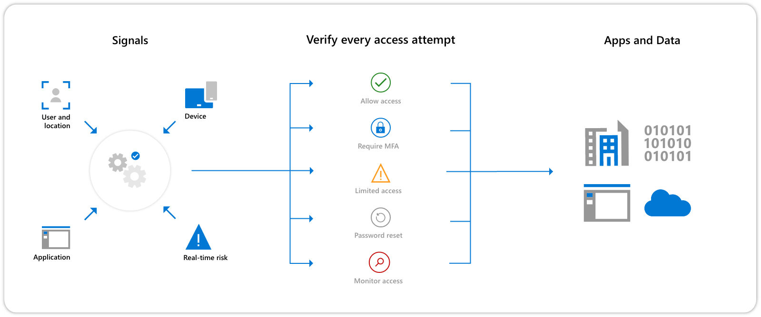
Azure AD Conditional Access
Citation: timw.info/29f

Slide 14

Azure AD Domain Services
Citation: timw.info/

Slide 15
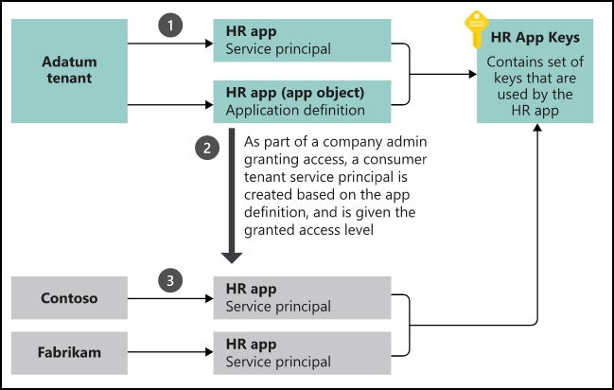
Service Principals
Citation: timw.info/

Slide 16
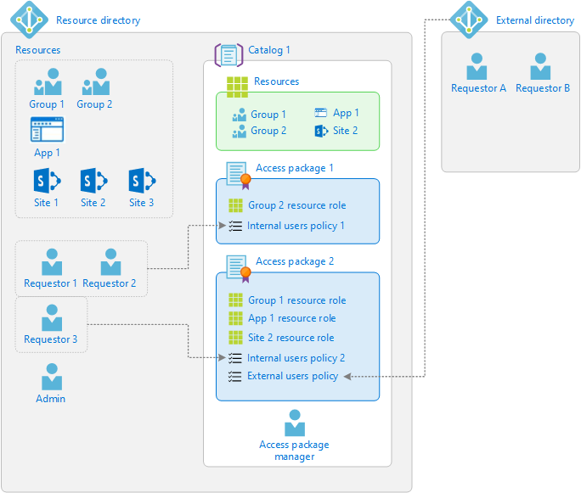
Azure AD Entitlement Management
Citation: timw.info/kii

Slide 17
Demo

Slide 18
Day 2

Slide 19
Day 2 Learning Goals
Azure Roles and Custom Roles
Azure AD Privileged Identity Management
Managing Management vs Data Plane Access
Azure Policy
Authorization

Slide 20

Azure AD Tenants and Subscriptions
Citation: timw.info/az500

Slide 21

Azure Management Scopes
/ Tenant Root
Citation: timw.info/az500

Slide 22
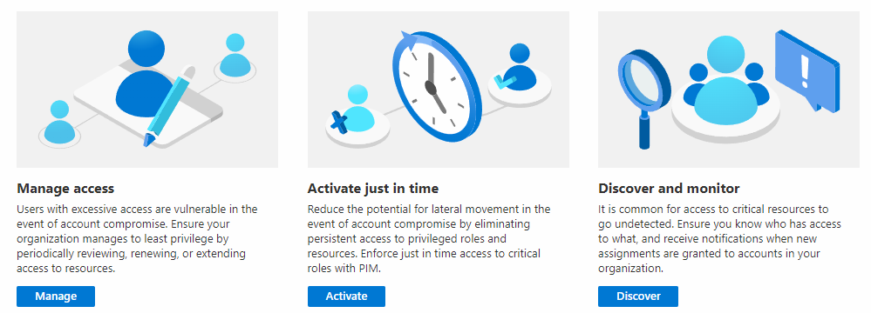
Azure AD PIM
Citation: timw.info/

Slide 23
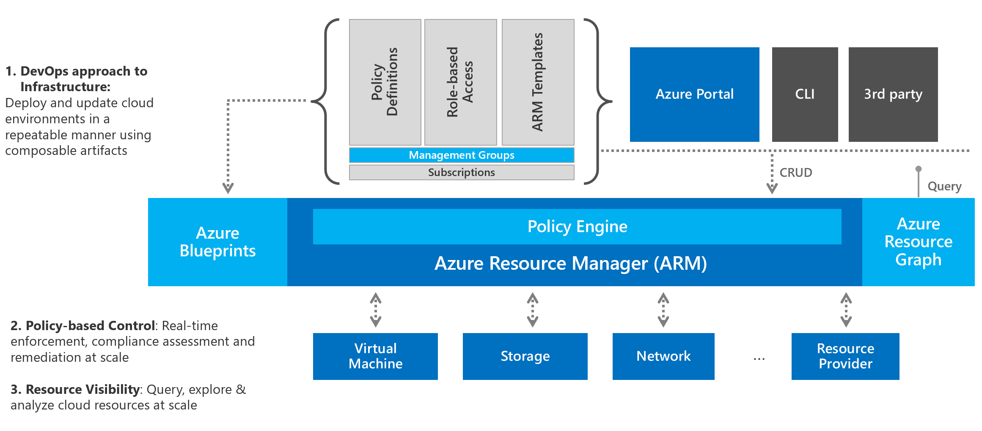
Azure Policy & Machine Configuration
Citation: timw.info/kkz

Slide 24
Content Placeholder
Citation: timw.info/

Slide 25
Demo

Slide 26
Day 3

Slide 27
Day 3 Learning Goals
Azure AD Hybrid Identity
Azure AD Guest Users
Azure AD B2C
Azure App Service Authentication
Azure Log Analytics
Microsoft Defender for Cloud
Accounting

Slide 28
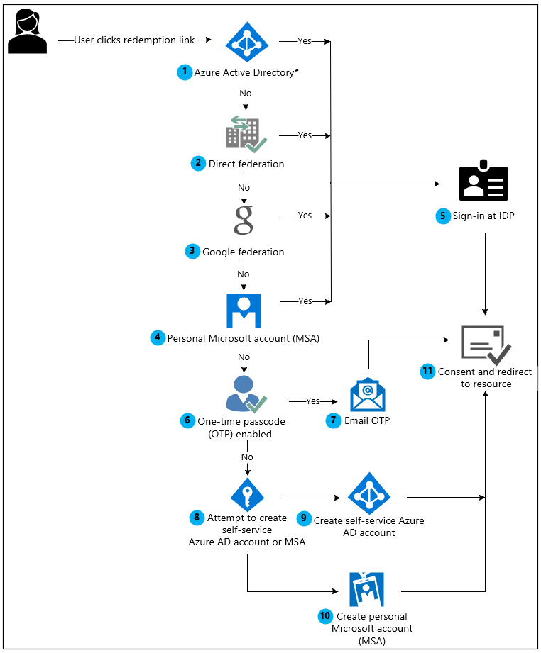
Azure AD B2B Collaboration
Citation: timw.info/7o8

Slide 29

Azure AD B2C
Citation: timw.info/

Slide 30

Azure AD Hybrid Identity
Citation: timw.info/az500

Slide 31
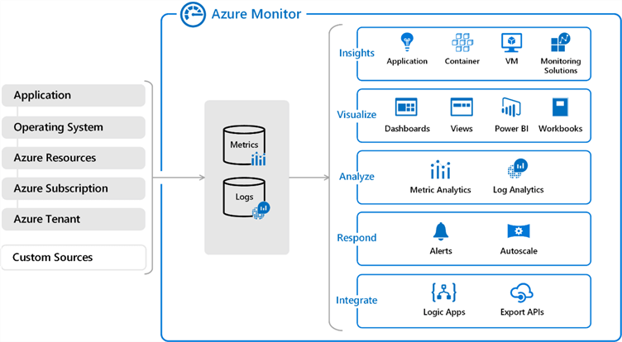
Azure Log Analytics
Citation: timw.info/qxz

Slide 32
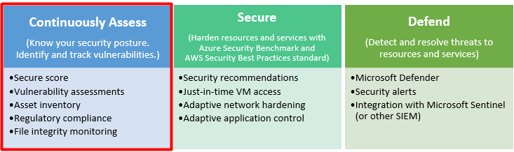
Microsoft Defender for Cloud
Citation: timw.info/1on

Slide 33

Microsoft Sentinel
Citation: timw.info/1on

Slide 34
Demo

